Slide 1
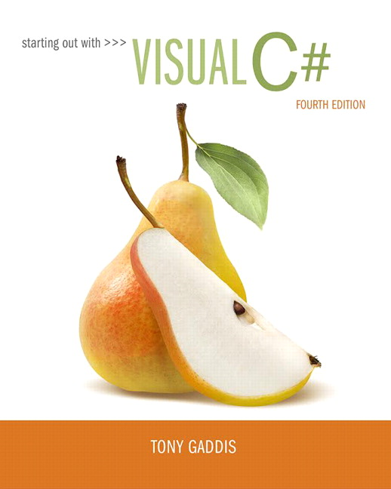
Starting out with Visual
Fourth Edition
Chapter 5
Loops, File, and Random Numbers
Copyright © 2017, 2014, 2012 Pearson Education, Inc. All Rights Reserved
Notes:
If this PowerPoint presentation contains mathematical equations, you may need to check that your computer has the following installed:
1) MathType Plugin
2) Math Player (free versions available)
3) NVDA Reader (free versions available)

Slide 2
Topics
5.1 More About ListBoxes
5.2 The while Loop
5.3 The
Operators
5.4 The for Loop
5.5 The do-while Loop
5.6 Using Files for Data Storage
5.7 The OpenFileDialog and SaveFileDialog Controls
5.8 Random Numbers
5.9 The Load Event

Slide 3


5.1 More About ListBoxes
ListBox controls have various methods and properties that you can use in code to manipulate the ListBox’s contents
The Items.Add method allows you to add an item to the ListBox control
  where ListBoxName is the name of the ListBox control; Item is the value to be added to the Items property
The Items.Clear method can erase all the items in the Items proeprty
The Count property reports the number of items stored in the ListBox

Slide 4
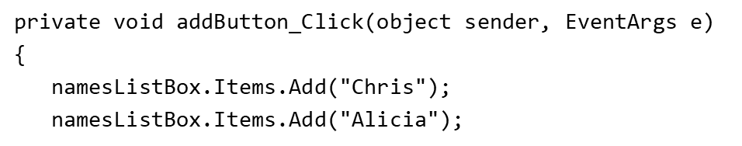
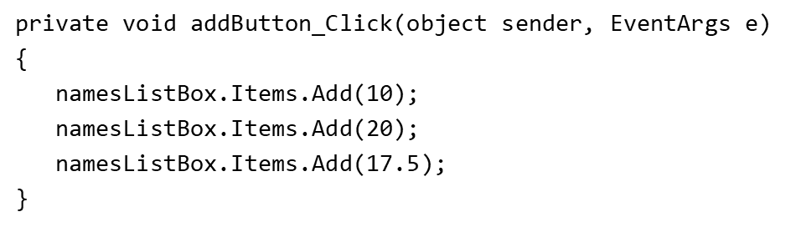
Sample Codes
You can add string literals
You can add values of other types as well

Slide 5
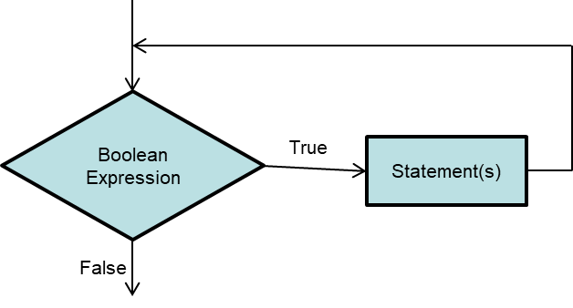
5.2 The while Loop
The while loop causes a statement or set of statements to repeat as long as a Boolean expression is true
The simple logic is: While a Boolean expression is true, do some task
A while loop has two parts:
  A Boolean expression that is tested for a true or false value
  A statement or set of statements that is repeated a long as the Boolean expression is true

Slide 6
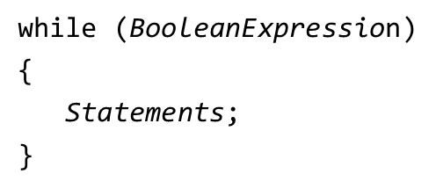
Structure of a while Loop
In
the generic format of a while loop is:
The first line is called the while clause
Statements inside the curly braces are the body of the loop
When a while loop executes, the Boolean expression is tested. If true, the statements are executed
Each time the loop executes its statement or statements, we say the loop is iterating, or performing an iteration

Slide 7


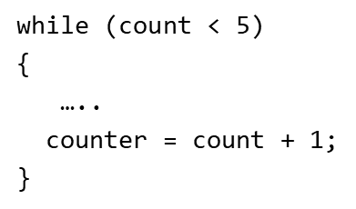
The while Loop is a Pretest Loop
A while loop tests its condition before performing an iteration.
It is necessary to declare a counter variable with initial value
So the while clause can test its Boolean expression
Inside the curly braces, there must exist a statement that defines increment (or decrement) of the counter

Slide 8
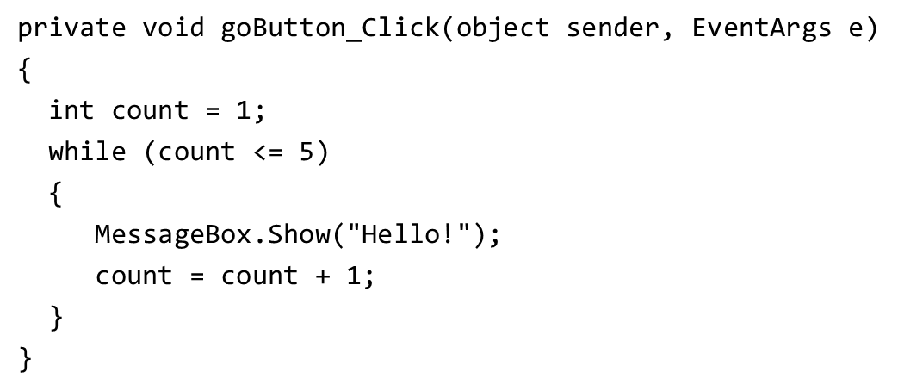
Sample Code (1 of 4)
The counter has an initial value of 1
Each time the loop executes, 1 is added to counter
The Boolean expression will test whether counter is less than or equal 5. So the loop will stop when counter equals 5.

Slide 9
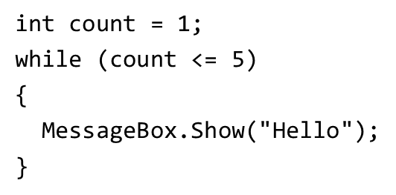
Infinite Loops
An infinite loop is a loop that will repeats until the program is interrupted
There are few conditions that cause a while loop to be an infinite loop. A typical scenario is that the programmer forgets to write code that makes the test condition false
In the following example, the counter is never increased. So, the Boolean expression is never false.

Slide 10
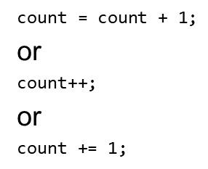
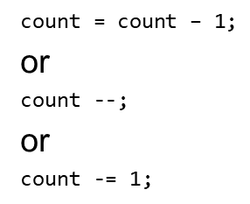
5.3 The increment and decrement Operators
To increment a variable means to increase its value, and to decrement a variable means to decrease its value
This
operator to increment and decrement variables
Adding 1 to a variable can be written as:
Subtracting 1 from a variable can be written as:

Slide 11
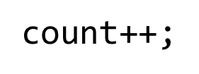
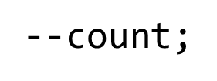
Postfix Mode versus Prefix Mode
Postfix mode means to place the
operators after their operands
Prefix mode means to place the
operators before their operands

Slide 12
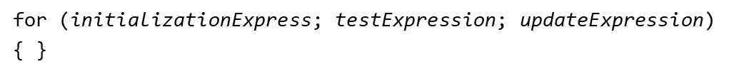
5.4 The for Loop
The for loop is specially designed for situations requiring a counter variable to control the number of times that a loop iterates
You must specify three actions:
  Initialization: a one-time expression that defines the initial value of the counter
  Test: A Boolean expression to be tested. If true, the loop iterates.
  Update: increase or decrease the value of the counter
A generic form is:
The for loop is a pretest loop

Slide 13
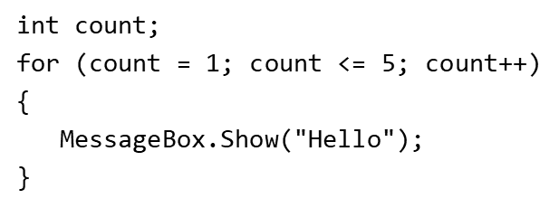
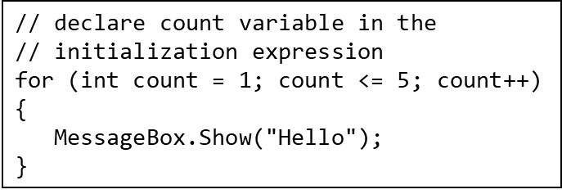
Sample Code (2 of 4)
The initialization expression assign 1 to the count variable
The expression count
is tested. If true, continue to display the message.
The update expression add 1 to the count variable
Start the loop over

Slide 14
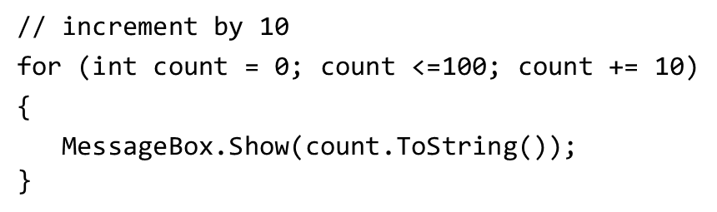
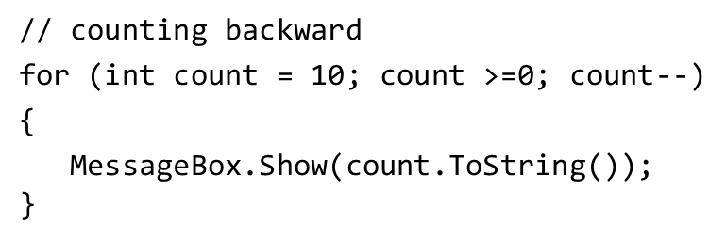
Other Forms of Update Expression
In the update expression, the counter variable is typically incremented by 1. But, this is not a requirement.
You can decrement the counter variable to make it count backward

Slide 15
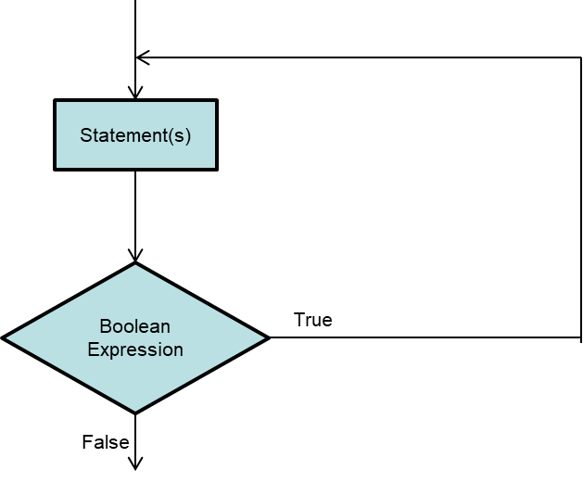
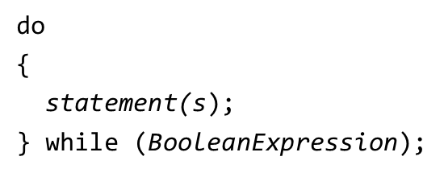
5.5 The do-while Loop
The do-while loop is a posttest loop, which means it performs an iteration before testing its Boolean expression.
In the flowchart, one or more statements are executed before a Boolean expression is tested
A generic format is:

Slide 16
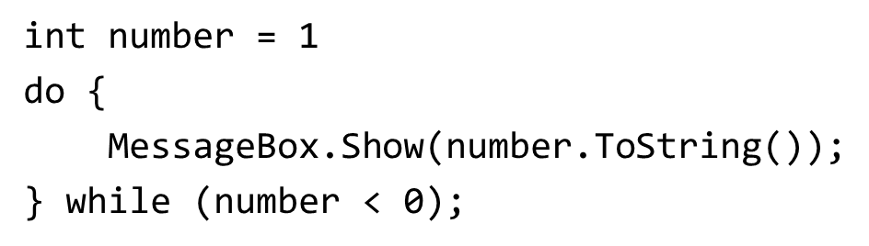
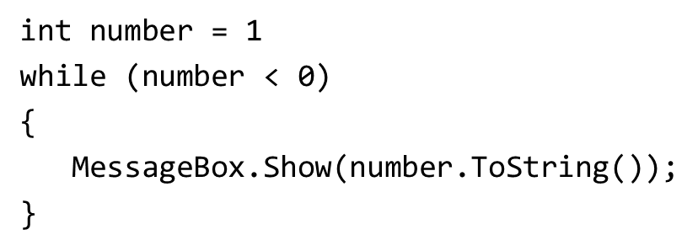
Sample Code (3 of 4)
Will you see the message box?
Will you see the message box?

Slide 17
5.6 Using File for Data Storage
When a program needs to save data for later use, it writes the data in a file
There are always three steps:
  Open the file: create a connection between the file and the program
  Process the file: either write to or read from the file
  Close the file: disconnect the file and the program
In general, there are two types of files:
  Text file: contains data that has been encoded as test using scheme such as Unicode
  Binary file: contains data that has not been converted to text. You cannot view the contents of binary files with a text editor.
This chapter only works with text files

Slide 18

File Accessing
A file object is an object that is associated with a specific file and provides a way for the program to work with that file
The .N E T Framework provide two classes to create file objects through the System.I O namespace
  StreamWriter: for writing data to a text file
  StreamReader: for reading data from a text file
You need to write the following directives at the top of your program

Slide 19

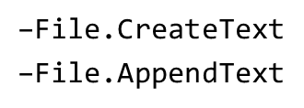
Writing Data to a File
Start with creating a StreamWriter object
Use one of the File methods to open the file to which you will be writing data. Sample File methods are:
Use the Write or WriteLine method to write items of data to the file
Close the connection.

Slide 20
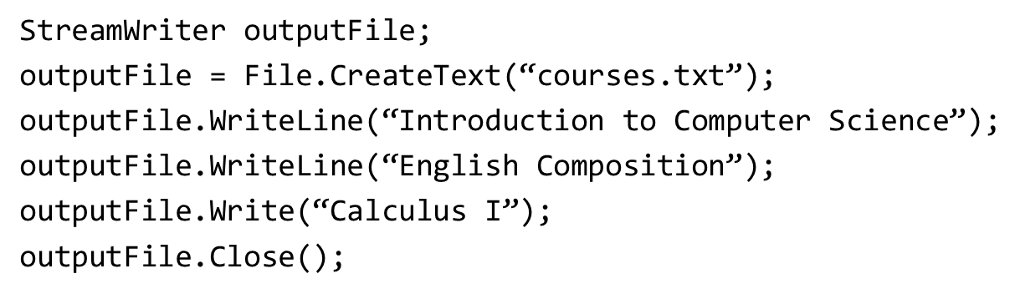
Sample Code (4 of 4)
The WriteLine method writes an item of data to a file and then writes a newline characters which specifies the end of a line
The Write method writes an item to a file without a newline character

Slide 21
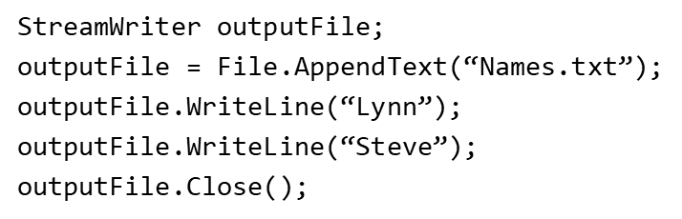
CreateText versus AppendText
The previous code uses the File.CreateText method for the following reasons:
  It creates a text file with the name specified by the argument. If the file already exists, its contents are erased
  It creates a StreamWriter object in memory, associated with the file
  It returns a reference to the StreamWriter object
When there is a need not to erase the contents of an existing file, use the AppendText method

Slide 22
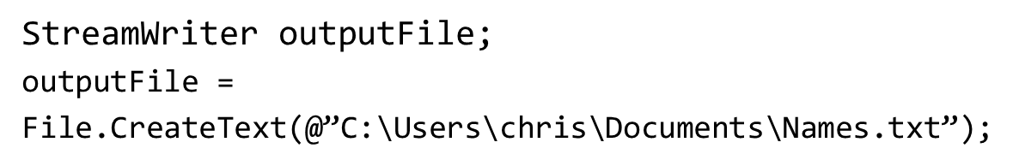
Specifying the Location of an Output File
If you want to open a file in a different location, you can specify a path as well as filename in the argument
Be sure to prefix the string with the @ character

Slide 23

Reading Data from a File
Start with creating a StreamReader object
Use the File.OpenText method to open the file to which you will be writing data
Use the Read or ReadLine method to write items of data to the file
  StreamReader.ReadLine: Reads a line of characters from the current stream and returns the data as a string.
  StreamReader.Read: Reads the next character or next set of characters from the input stream.
Close the connection

Slide 24
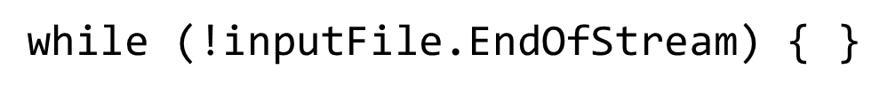
Reading a File with a Loop
StreamReader objects have a Boolean property named EndOfStream that signals whether or not the end of file has been reached
You can write a loop to detect the end of the file.
Or

Slide 25
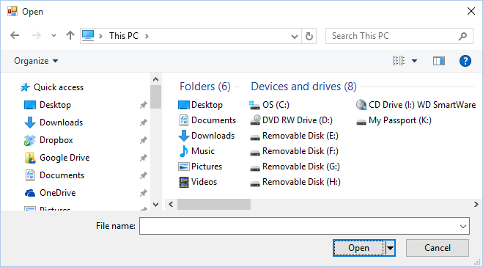
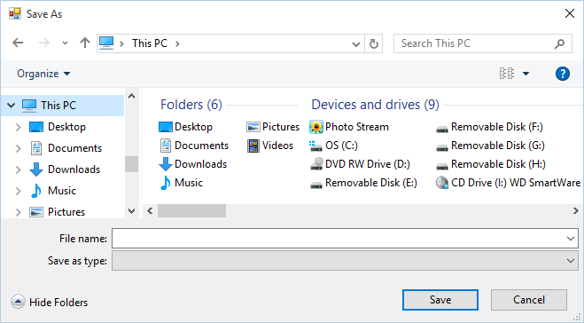
5.7 The OpenFileDialog and SaveFileDialog Controls
The OpenFileDialog and SaveDialog controls allow your application to display standard Windows dialog boxes for opening and saving files
Unlike Label, Button, and TextBox, they are invisible controls
The OpenFileDialog control displays a standard Windows Open dialog box.
The SaveDialog control displays a standard Windows Save As dialog box

Slide 26
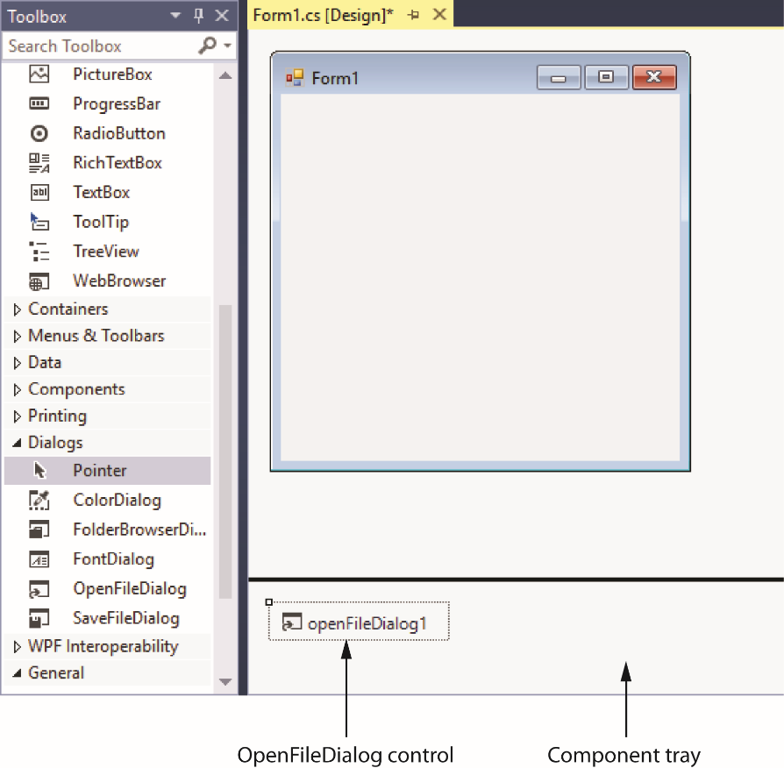
Displaying an Open Box (1 of 2)
When adding an OpenFileDialog control to the form, it does not appear on the form, but in an area at the bottom of the Designer called the component tray

Slide 27
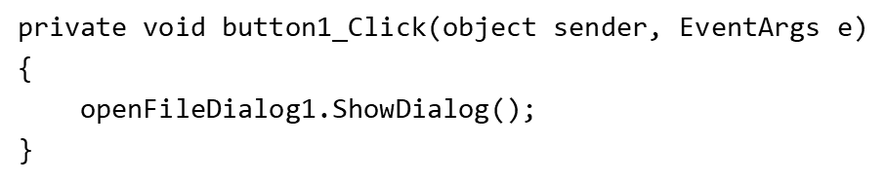
Displaying an Open Box (2 of 2)
In code, you can display an Open dialog box by calling the ShowDialog method:

Slide 28
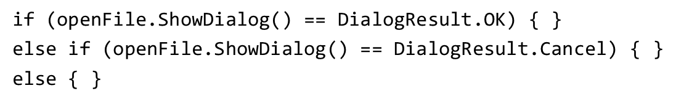
Detecting the User’s Selection
The showDialog method returns a value that indicates which button the user clicks to dismiss the dialog box
  If the user clicked the Open button, the value DialogResult.OK is returned
  If the user clicked the Cancel button, the value DialogResult.Cancel is returned
  The following is an example that calls the ShowDialog method to determine the user’s choice:

Slide 29
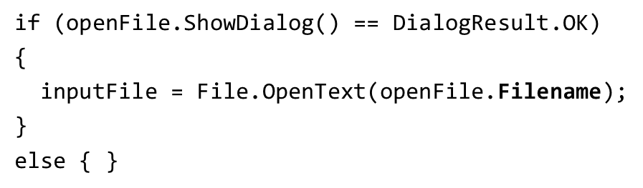
The Filename and InitialDirectory Property
When the user selects a file with the Open dialog box, the file’s path and filename are stored in the control’s Filename property
The following is an example of how to open the selected file:
You can specify a directory to be initially displayed with the InitialDirectory property. For example,

Slide 30

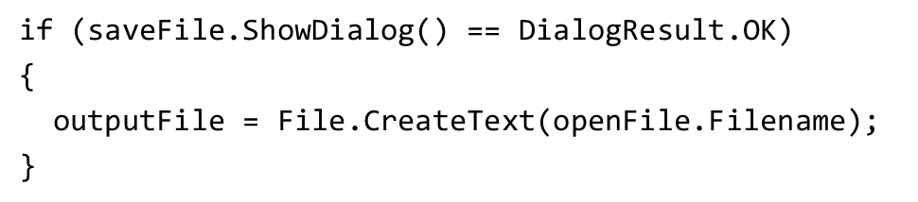
Displaying a Save as Dialog Box
Use the following to call the SaveFileDialog control’s ShowDialog method
Use the following to detect the user’s choice
Use the following to open the selected file

Slide 31

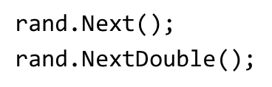
5.8 Random Numbers
The .N E T Framework provides the Random class to generate random numbers.
To create an object, use:
Two commonly used methods to generate random numbers are:
  Next: randomly create an integer
  NextDouble: randomly create a floating-point number from 0.0 to 1.0
Examples,

Slide 32


Syntax of Random.Next Method
Random.Next generates a random number whose value ranges from zero to 2,147,483,647
It also allow you to generate a random number whose value ranges from zero to some other positive number. The syntax is:
For example, to create a random number from 0 to 99, use:

Slide 33
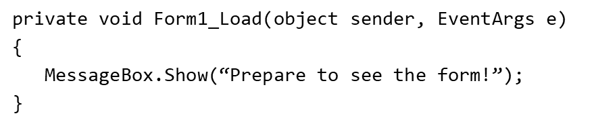
5.9 The Load Event
When running an application, the application’s form is loaded into memory and an event known as Load takes place
To create a Load event handler, simply double click the form in the Designer
An empty Load event handler looks like:
Any code you write inside the Load event will execute when the form is launched. For example,

Slide 34
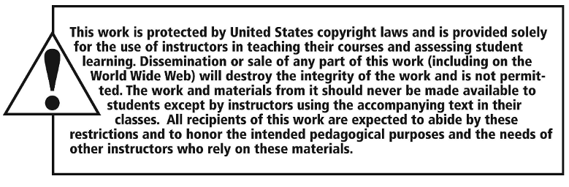
Copyright

