Slide 1
Starting out with Visual
Fourth Edition
Chapter 3
Processing Data
Copyright © 2017, 2014, 2012 Pearson Education, Inc. All Rights Reserved
Notes:
If this PowerPoint presentation contains mathematical equations, you may need to check that your computer has the following installed:
1) MathType Plugin
2) Math Player (free versions available)
3) NVDA Reader (free versions available)

Slide 2
Topics (1 of 2)
3.1 Reading Input with TextBox Controls
3.2 A First Look at Variables
3.3 Numeric Data Type and Variables
3.4 Performing Calculations
3.5 Inputting and Outputting Numeric Values
3.6 Formatting Numbers with the ToString Method
3.7 Simple Exception Handling
3.8 Using Named Constants

Slide 3
Topics (2 of 2)
3.9 Declaring Variables as Fields
3.10 Using the Math Class
3.11 More G U I Details
3.12 Using the Debugger to Locate Logic Errors

Slide 4
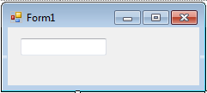
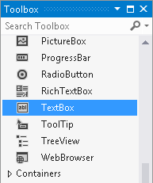
3.1 Reading Input with TextBox Control
TextBox control
a rectangular area
can accept keyboard input from the user
locates in the Common Control group of the Toolbox
double click to add it to the form
default name is textBoxn
where n is 1, 2, 3, …

Slide 5
The Text Property
A TextBox controls Text property stores the user inputs
Text property accepts only string values, e.g.
To clear the content of a TextBox control, assign an empty string(“”)

Slide 6
3.2 A First Look at Variables
A variable is a storage location in memory
Variable name represents the memory location
In
you must declare a variable in a program before using it to store data
The syntax to declare variables is:

Slide 7
Data Types
variable must be declared with a proper data type
The data type specifies the type of data a variable can hold
In
A
many data types are known as primitive data types
they store fundamental types of data
such as strings and integers

Slide 8
Variable Names
A variable name identifies a variable
Always choose a meaningful name for variables
Basic naming conventions are:
the first character must be a letter (upper or lowercase) or an underscore (_)
the name cannot contain spaces
do not use
keywords or reserved words

Slide 9
String Variables
String is a combination of characters
A variable of the string data type can hold any combination of characters, such as names, phone numbers, and social security numbers
Value of a string variable is assigned on the right of = operator surrounded by a pair of double quotes:
The following assigns the productDescription string to a Label control named productLabel:
You can also display a string variable in a Message Box:

Slide 10
String Concatenation
Concatenation is the appending of one string to the end of another string
In
+ operator is used for concatenation
Concatenation can happen between a string and another data type
int and string
double and string

Slide 11
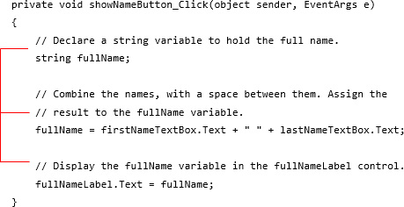
Declaring Variables Before Using Them
You can declare variables and use them later

Slide 12
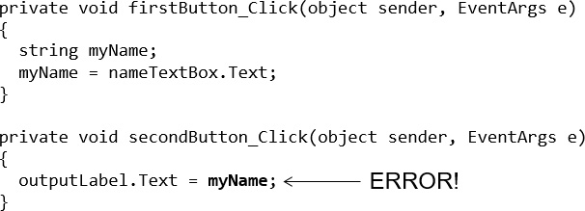
Local Variables and Scope
A local variable belongs to the method in which it was declared
Only statements inside that method can access the variable
Scope describes the part of a program in which a variable may be accessed
Lifetime of a variable is the time period during which the variable exists in memory while the program is executing

Slide 13
Rules of Variables
You can assign a value to a variable only if the value is compatible with the variable’s data type
A variable holds one value at a time
In
a variable must be assigned a value before it can be used. You can initialize the variable with a value when you declare it.
Multiple variables with the same type may be declared with one statement

Slide 14
3.3 Numeric Data Types and Variables
If you need to store a number in a variable and use the number in a mathematical operation, the variable must be of a numeric data type
Commonly used
numeric data types:
int: whole number in the range of -2,147,483,648 to 2,147,483,647
double: real numbers including numbers with fractional parts
Numeric literals is a number that is written into a program's code:
The value cannot be surrounded by quotes

Slide 15
The decimal Data Type
In
the decimal keyword indicates a 128-bit data type
Compared to double types, it has more precision and a smaller range, which makes it appropriate for financial and monetary calculations.
Be sure to add the letter M (or m) to a decimal value:

Slide 16
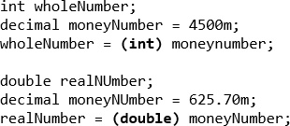
Explicit Conversion with Cast Operators
This
allows you to explicitly convert among types, which is known as type casting
You can use the cast operator which is simply a pair of parentheses with the type keyword in it

Slide 17
3.4 Performing Calculations
Basic calculations such as arithmetic calculation can be performed by math operators
Operator | Name of the operator | Description
+ | Addition | Adds two numbers
− | Subtraction | Subtracts one number from another
* | Multiplication | Multiplies one number by another
/ | Division | Divides one number by another and gives the quotient
% | Modulus | Divides one number by another and gives the remainder

Slide 18
Rules for Performing Calculations
A math expression performs a calculation and gives a value
Be sure to follow the order of operations and group with parentheses if necessary
In a calculation of mixed data type, the data type of the result is determined by:
When an operation involves an int and a double, int is treated as double and the result is double
When an operation involves an int and a decimal, int is treated as decimal and the result is decimal
An operation involving a double and a decimal is not allowed.

Slide 19
Integer Division
When you divide an integer by an integer in
the result is always given as an integer. The result of the following is 2.
This is known as integer division. To avoid it:

Slide 20
3.5 Inputting and Outputting Numeric Values
Input collected from the keyboard are considered combinations of characters (or string literals) even if they look like a number to you
A TextBox control reads keyboard input, such as 25.65. However, the TextBox treats it as a string, not a number.
In
use the following Parse methods to convert string to numeric data types
int.Parse
double.Parse
decimal.Parse
Examples:

Slide 21
Displaying Numeric Values
The Text property of a control only accepts string literals
To display a number in a TextBox or Label control requires you to convert a numeric data to string type
In
all variables work with ToString method that can convert variables’ values to string:
Another option is “implicit string conversion with the + operator”:

Slide 22
3.6 Formatting Numbers with the ToString Method
The ToString method can optionally format a number to appear in a specific way
The following table lists the “format strings” and how they work with sample outputs
Format String | Description | Number | ToString() | Result
"N" or "n" | Number format | 12.3 | ToString("n3") | 12.300
"F" or "f" | Fixed-point scientific format | 123456.0 | ToString("f2") | 123456.00
"E" or "e" | Exponential scientific format | 123456.0 | ToString("e3") | 1.235e+005
"C" or "c" | Currency format | -1234567.8 | ToString("C") | ($1,234,567.80)
"P" or "p" | Percentage format | .234 | ToString("P") | 23.40%

Slide 23
3.7 Simple Exception Handling
An exception is an unexpected error that happens while a program is running
If an exception is not handled by the program, the program will abruptly halt
This
allows you to write codes that responds to exceptions. Such codes are known as exception handlers.
In
the structure is called a try-catch statement
The try block is where you place the statements that could have exception
The catch block is where you place statements as response to the exception when it happens

Slide 24
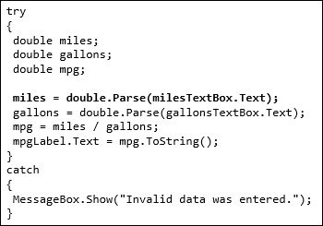
Throwing an Exception
In the following example, the user may entered invalid data (e.g. null) to the milesText control. In this case, an exception happens (which is commonly said to “throw an exception”).
The program then jumps to the catch block.
You can use the following to display an exception’s default error message:

Slide 25
3.8 Using Named Constants
A number constant is a name that represents a value that cannot be changed during the program's execution
In
a constant can be declared by const keyword
Writing the name of a constant in uppercase letters is traditional in many programming languages, but is not a requirement.

Slide 26
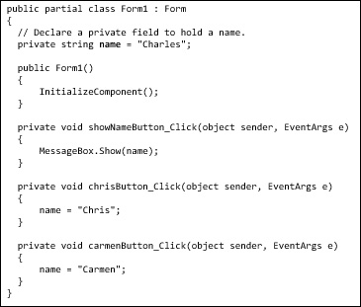
3.9 Declaring Variables as Fields
A field is a variable that is declared at the class level
It is declared inside the class, but not inside of any method
A field is a special type of variable
A field’s scope is the entire class
In the Field Demo application, the name variable is a field
The name field is created in memory when the Form1 form is created

Slide 27
3.10 Using the Math Class
The .NET Framework’s Math class provides several methods for performing complex mathematical calculations
Math.Sqrt(x): returns the square root of x (a double).
Math.Pow(x, y): returns the value of x raised to the power of y. Both x and y are double.
There are two predefined constants:
Math.P I: represents the ratio of the circumference of a circle to its diameter.
Math.E: represents the natural logarithmic base

Slide 28
3.11 More G U I Details – Tab Order
When an application is running, one of the form’s controls always has the focus
Focus means a control receives the user’s keyboard input
When a button is focused, pressing the Enter key can execute the button’s Click event handler
The order in which controls receives the focus is called the tab order
When the user presses the tab key to select controls, the program will follow the tab order
The TabIndex property contains a numeric value indicating the control’s position in the tab order
The value starts with 0. The index of first control is 0, the nth control is n-1.

Slide 29
Tab Order (1 of 2)
To set the tab order of a control, click Tab Order on the View menu. This activates the tab-order selection mode on the form.
Simply click the controls with the mouse in the order you want.
Notice that Label controls do not accept input from the keyboard. They cannot receive focus.
Their TabIndex values are irrelevant

Slide 30
Tab Order (2 of 2)
You can use the Focus method to change the focus using the following syntax
The following changes the focus to nameTextBox when the user clicks clearButton:

Slide 31
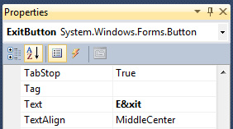
Assign Keyboard Access Key to Buttons
An access key (or mnemonic) is a key that is pressed in combination with the Alt key to quickly access a control
You can assign an access key to a button’s Text property by adding an ampersand (&) before a letter
The user can use a keystroke Alt + X or Alt + x.
Access key does not distinguish between uppercase and lowercase

Slide 32
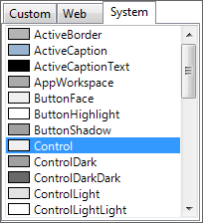
Setting Colors
Forms and most controls have a BackColor property
Controls that can display Text also have a ForeColor property
These color-related properties support a drop-down list of colors
The list has tree tabs:
Custom: display a color palette
Web: list colors displayed with consistency in Web browsers
System: list colors defined in current Windows
You can set colors in color
The .NET Framework provides numerous values that represent colors

Slide 33
Background Images for Forms
A Form has a property named BackgroundImage that is similar to the Image property of a PictureBox.
Simply import an image to the Select Resource window
A Form also has a BackgroundImageLayout property that is similar to the SizeMode property of a PictureBox.
Choose from one of the following options

Slide 34
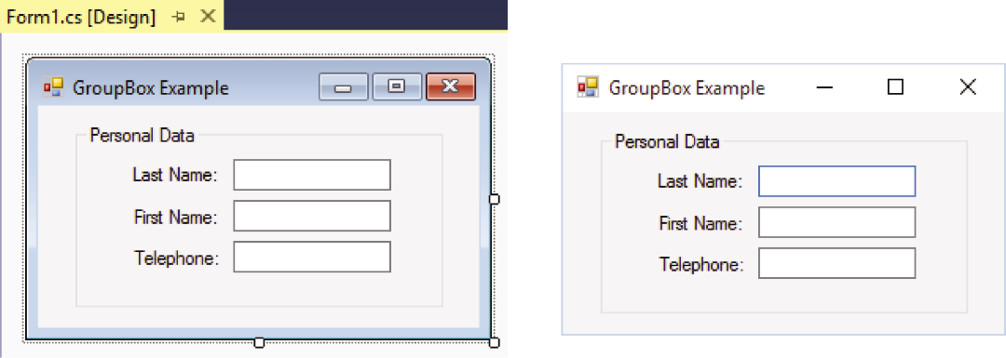
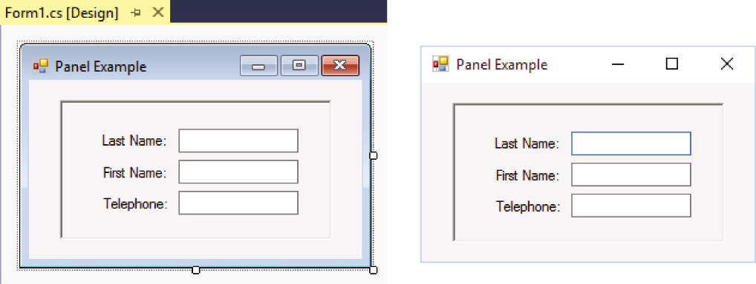
GroupBoxes versus Panels
A GroupBox control is a container with a thin border and an optional title that can hold other controls
A Panel control is also a container that can hold other controls
There are several primary differences between a Panel and GroupBox:
A panel cannot display a title and does not have a Text property, but a GroupBox supports these two properties.
A panel’s border can be specified by its BorderStyle property, while the GroupBox cannot be

Slide 35
3.12 Using the Debugger to Locate Logic Errors
A logic error is a mistake that does not prevent an application from running, but causes the application to produce incorrect results.
Mathematical errors
Assigning a value to the wrong variable
Assigning the wrong value to a variable
etc.
Finding and fixing a logic error usually requires a bit of detective work.
Visual Studio provides debugging tools that make locating logic errors easier.

Slide 36
Breakpoints (1 of 2)
A breakpoint is a line you select in your source code.
When the application is running and it reaches a breakpoint, the application pauses and enters break mode.
While the application is paused, you may examine variable contents and the values stored in certain control properties.

Slide 37
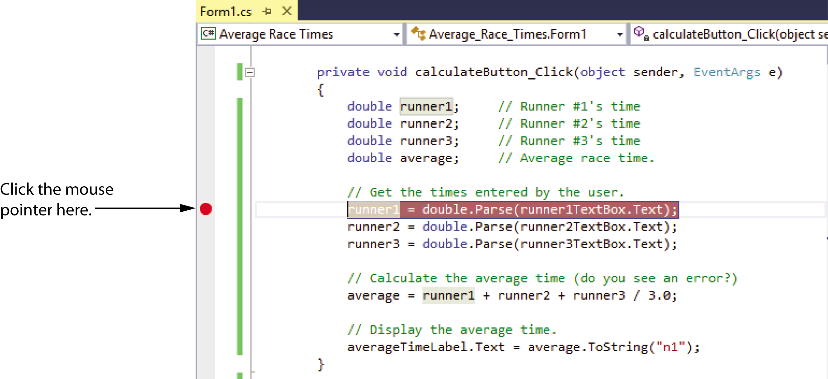
Breakpoints (2 of 2)

Slide 38
Break Mode
In Break mode, to examine the contents of a variable or control property, hover the cursor over the variable or the property's name in the Code editor.

Slide 39
Autos, Locals, and Watch Windows
The Autos window displays a list of the variables appearing in the current statement, the three statements before, and the three statements after the current statement. The current value and the data type of each variable are also displayed.
The Locals window displays a list of all the variables in the current procedure. The current value and the data type of each variable are also displayed.
The Watch window allows you to add the names of variables you want to watch. This window displays only the variables you have added. Visual Studio lets you open multiple Watch windows.
You can open any of these windows by clicking Debug on the menu bar, then selecting Windows, and then selecting the window that you want to open.

Slide 40
The Locals Window

Slide 41
Single-Stepping (1 of 2)
Visual Studio allows you to single-step through an application’s code once its execution has been paused by a breakpoint.
This means that the application's statements execute one at a time, under your control.
After each statement executes, you can examine variable and property values.
This process allows you to identify the line or lines of code causing the error.

Slide 42
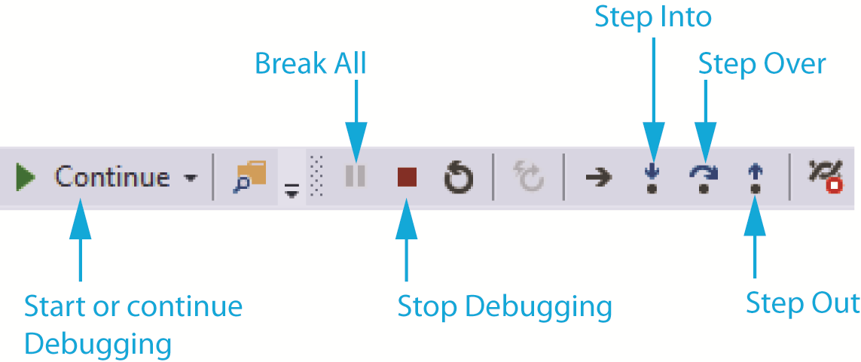
Single-Stepping (2 of 2)
To single-step, do any of the following:
Press F11 on the keyboard, or
Click the Step Into command on the toolbar, or
Click Debug on the menu bar, and then select Step Into from the Debug menu

Slide 43
Copyright

