Slide 1
Copyright © 2017 Pearson Education, Inc.
Chapter 2
Introduction to Visual C#

Slide 2
Topics
2.1 Getting Started with Forms and Controls
2.2 Creating the GUI for Your First Visual C# Application
2.3 Introduction to C# Code
2.4 Writing Code for the Hello World Application
2.5 Label Control
2.6 Making Sense of IntelliSense
2.7 PictureBox Controls
2.8 Comments, Blank Lines, and Indentation
2.9 Writing the Code to Close an Application's Form
2.10 Dealing with Syntax Error
Copyright © 2017 Pearson Education, Inc.

Slide 3
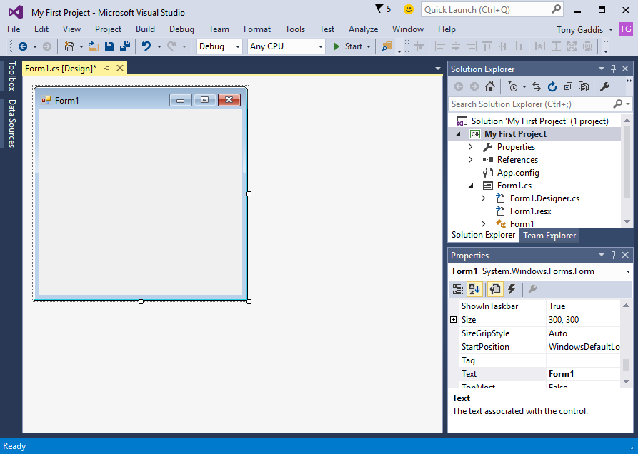
2.1 Getting Started with Forms and Controls
A Visual C# application project starts with creating its GUI with
Designer
Toolbox
Property window
In the Designer, an empty form is
automatically created
An application's GUI is made of forms and controls
Each form and control in the application's GUI must have a name as ID. The default blank form is named "Form1" automatically.
The project's form
Copyright © 2017 Pearson Education, Inc.

Slide 4
Form's Bounding Box and Sizing Handles
The default empty form has a dimension (size) of 300 pixels wide by 300 pixels high
A form in Designer is enclosed with thin dotted lines called the bounding box
The bounding box has small sizing handles; you can use them to resize the form
Thin dotted line
Sizing handle
Copyright © 2017 Pearson Education, Inc.

Slide 5
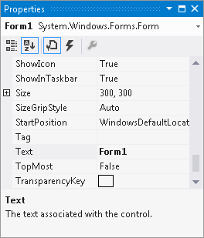
The Property Window
The appearance and other characteristics of a GUI object are determined by the object's properties
The Properties window lists all properties
When selecting an object, its properties are displayed in Properties windows
Each property has 2 columns:
Left: property's name
Right: property's value
Copyright © 2017 Pearson Education, Inc.

Slide 6
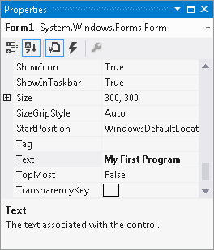
Changing a Property's Value
Select an object, such as the Form, by clicking it once
Click View and select Properties if the Properties window is not available
Find the property's name in the list and change its value
The Text property determines the text to be displayed in the form's title bar
Example: Change the
value from "Form1"
to
"My First Program"
Copyright © 2017 Pearson Education, Inc.

Slide 7
Adding Controls to a Form
In the Toolbox, select the Control (e.g. a Button), then you can either:
double click the Button control
click and drag the Button control to the form
On the form, you can
resize the control using its bounding box and sizing handles
move the control's position by dragging it
change its properties in the Properties window
Copyright © 2017 Pearson Education, Inc.

Slide 8
Rules for Naming Controls
Controls' name are identifiers of the controls
The naming conventions are:
The first character must be a letter (lower or uppercase does not matter) or an underscore (_)
All other characters can be alphanumerical characters or underscores
The name cannot contain spaces
Examples of good names are:
showDayButton
DisplayTotal
_ScoreLabel
Naming convention in our class:
Use abbreviations of the control to precede the name – for example btn_Start, lb_display, tb_EnterName, etc.
Copyright © 2017 Pearson Education, Inc.

Slide 9
2.2 Creating the GUI for Your First Visual C# Application
Components: a Form and a Button control
Purpose:
Create the application's GUI
Write the code that causes "Hello World" to appear when the user clicks the button (details are available in section 2.3)
Copyright © 2017 Pearson Education, Inc.

Slide 10
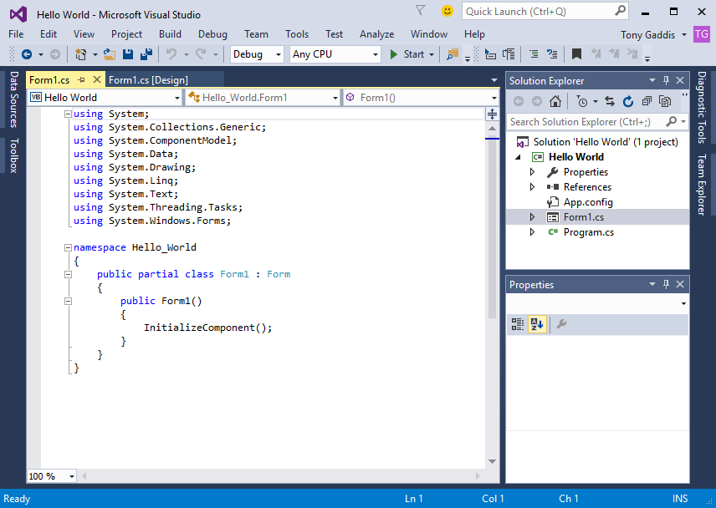
2.3 Introduction to C# Code
C# code is primarily organized in three ways:
Namespace: a container that holds classes
Class: a container that holds methods
Method: a group of one or more programming statements that perform some operations
A file that contains program code is called a source code file
Copyright © 2017 Pearson Education, Inc.

Slide 11
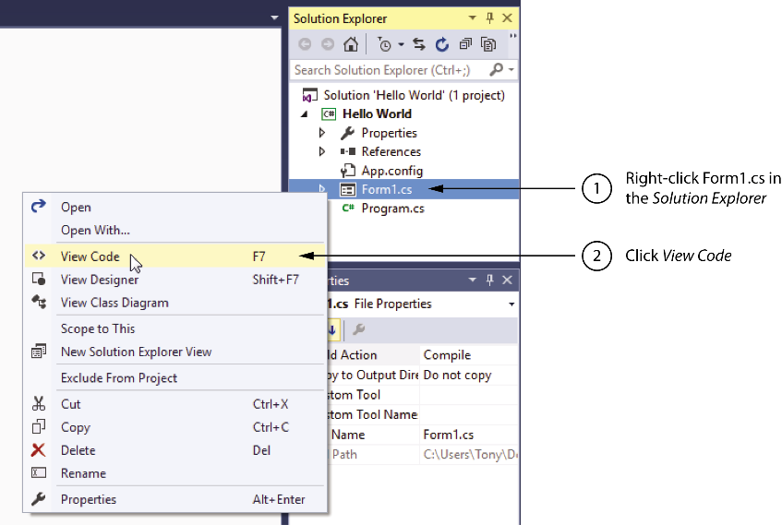
Source Codes in the Solution Explorer
Each time a new project is created the following two source code files are automatically created:
Program.cs file: contains the application's start-up code to be executed when the application runs
Form1.cs contains code that is associated with the Form1 form
You can open them through the Solution Explorer
Copyright © 2017 Pearson Education, Inc.

Slide 12
Organization of the Form1.cs
A sample of Form1.cs:
The using directives indicate which namespaces of .NET Framework this program will use.
The user-defined namespace of the project not .NET Framework namespaces
Class declaration
A method
C# code is organized as methods, which are contained inside classes, which are contained inside namespaces
using System;
using System.Collections.Generic;
using System.ComponentModel;
using System.Data;
using System.Drawing;
using System.Linq;
using System.Text;
using System.Windows.Forms;
namespace Hello_World
{
public partial class Form1 : Form
{
public Form1()
{
InitializeComponent();
}
}
}
1
2
3
4
Copyright © 2017 Pearson Education, Inc.

Slide 13
Adding Your Code
GUI applications are event-driven which means they interact with users
An event is a user's action such as mouse clicking, key pressing, etc.
Double clicking a control, such as Button, will link the control to a default Event Handler
An event handler is a method that executes when a specific event takes place
A code segment similar to the following will be created automatically:
private void myButton_Click(object sender, EventArgs e)
{
}
Copyright © 2017 Pearson Education, Inc.

Slide 14
Message Boxes
A message box (aka dialog box) displays a message
The .NET Framework provides a method named MessageBox.Show
C# can use it to pop up a window and display a message. A sample code is (bold line):
private void myButton_Click(object sender, EventArgs e)
{
MessageBox.Show("Thanks for clicking the button!");
}
Placing it in the myButton_Click event handler can display the string in the message box when the button is clicked
Copyright © 2017 Pearson Education, Inc.

Slide 15
2.4 Writing Code for the Hello World Application
The completed source code of Form1.cs is:
using System;
using System.Collections.Generic;
using System.ComponentModel;
using System.Data;
using System.Drawing;
using System.Linq;
using System.Text;
using System.Windows.Forms;
namespace Hello_World
{
public partial class Form1 : Form
{
public Form1()
{
InitializeComponent();
}
private void myButton_Click(object sender, EventArgs e)
{
MessageBox.Show("Thanks for clicking the button!");
}
}
}
Copyright © 2017 Pearson Education, Inc.

Slide 16
2.5 Label Controls
A Label control displays text on a form and can be used to display unchanging text or program output
Commonly used properties are:
Text: gets or sets the text associated with Label control
Name: gets or sets the name of Label control
Font: allows you to set the font, font style, and font size
BorderStyle: allows you to display a border around the control's text
AutoSize: controls the way they can be resized
TextAlign: set the text alignments
Copyright © 2017 Pearson Education, Inc.

Slide 17
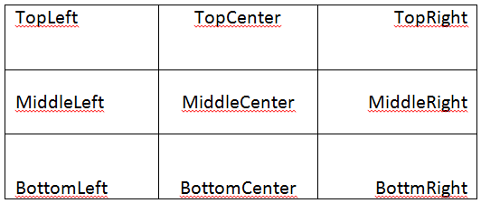
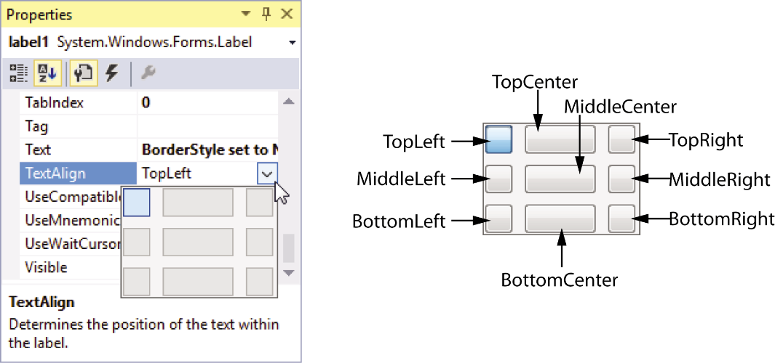
Handling Text Alignments
The TextAlign property supports the following values:
You can select them by clicking the down-arrow button of the TextAlign property
Copyright © 2017 Pearson Education, Inc.

Slide 18
Using Code to Display Output in a Label Control
By adding the following bold line to a Button's event handler, a Label control can display output of the application.
private void showAnswerButton_Click(object sender, EventArgs e)
{
answerLabel.Text = "Theodore Roosevelt";
}
Notice that
the equal sign (=) is known as assignment operator
the item receiving value must be on the left of = operator
the Text property accepts string only
if you need to clear the text of a Label, simply assign an empty string ("") to clear the Text property
Copyright © 2017 Pearson Education, Inc.

Slide 19
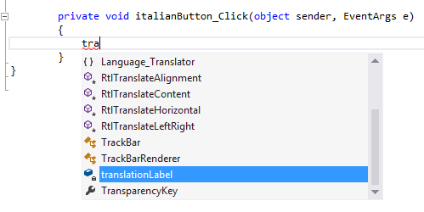
2.6 Making Sense of IntelliSense
IntelliSense provides automatic code completion as you write programming statements
It provides an array of options that make language references easily accessible
With it, you can find the information you need, and insert language elements directly into your code
Copyright © 2017 Pearson Education, Inc.

Slide 20
2.7 PictureBox Controls
A PictureBox control displays a graphic image on a form
Commonly used properties are:
Image: specifies the image that it will display
SizeMode: specifies how the control's image is to be displayed
Visible: determines whether the control is visible on the form at run time
Copyright © 2017 Pearson Education, Inc.

Slide 21
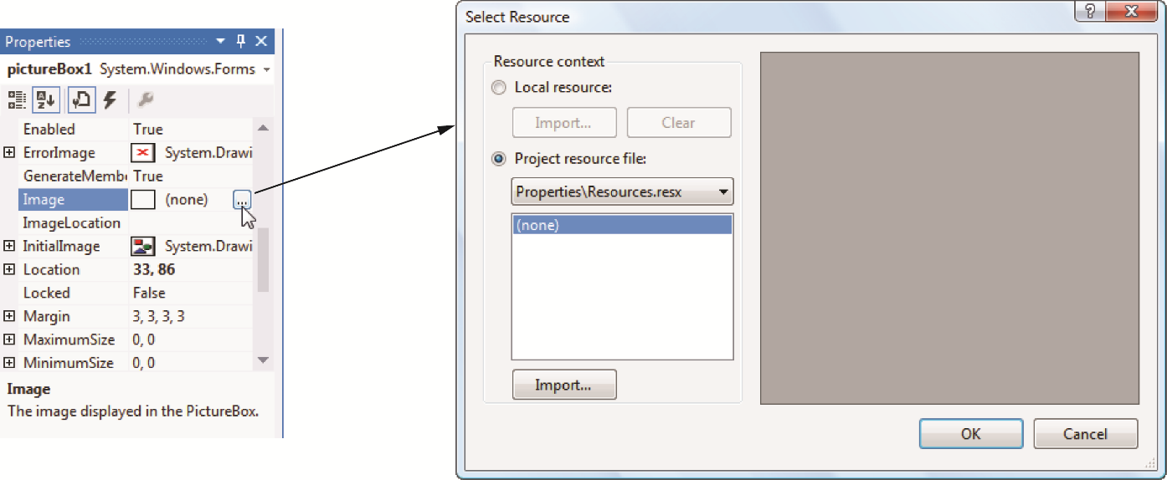
The Image Property's Select Resource Window
The Image Property has a Select Resource window. To use it:
click the ellipses button to open it
click the Import button and locate the
image file to display
Copyright © 2017 Pearson Education, Inc.

Slide 22
Creating Clickable Images
You can double click the PictureBox control in the Designer to create a Click event handler and then add your codes to it. For example,
private void catPictureBox_Click(object sender, EventArgs e)
{
MessageBox.Show("Meow");
}
And
private void spiderPictureBox_Click(object sender, EventArgs e)
{
spiderPictureBox.Visible = false
}
Copyright © 2017 Pearson Education, Inc.

Slide 23
Sequential Execution of Statements
Programmers need to carefully arrange the sequence of statements in order to generate the correct results
In the following example, the statements in the method execute in the order that they appear:
Private void showBackButton_Click(object sender, EventArgs e)
{
cardBackPictureBox.visible = true;
cardFacePictureBox.visible = true;
}
Incorrect arrangement of sequence can cause logic errors
Copyright © 2017 Pearson Education, Inc.

Slide 24
2.8 Comments, Blank Lines, and Indentation
Comments are brief notes that are placed in a program's source code to explain how parts of the program work
A line comment appears on one line in a program
// Make the image of the back visible
cardBackPictureBox.Visible = true;
A block comment can occupy multiple consecutive lines in a program
/*
Line one
Line two
*/
Copyright © 2017 Pearson Education, Inc.

Slide 25
Using Blank Lines and Indentation
Programmers frequently use blank lines and indentation in their codes to make the code more human-readable
Compare the following two identical codes:
namespace Wage_Calculator
{
public partial class Form1 : Form
{
public Form1()
{
InitializeComponent();
}
private void exitButton_Click(object sender, EventArgs e)
{
// Close the form.
this.Close();
}
}
}
namespace Wage_Calculator
{
public partial class Form1 : Form
{
public Form1()
{
InitializeComponent();
}
private void exitButton_Click(object sender, EventArgs e)
{
// Close the form.
this.Close();
}
}
}
Copyright © 2017 Pearson Education, Inc.

Slide 26
2.9 Writing Code to Close an Application's Form
To close an application's form in code, use the following statement:
this.Close();
A commonly used practice is to create an Exit button and manually add the code to it:
private void exitButton_Click(object sender, EventArgs e)
{
// Close the form.
this.Close();
}
Copyright © 2017 Pearson Education, Inc.

Slide 27
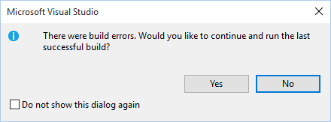
2.10 Dealing with Syntax Errors
Visual Studio code editor examines each statement as you type it and reports any syntax errors that are found
If a syntax error is found, it is underlined with a jagged line
If a syntax error exists and you attempt to compile and execute, you will see the following window
This jagged line indicates an error
Logic Errors?
Copyright © 2017 Pearson Education, Inc.
Notes:
Syntax Errors are very different from Logic Errors!
Logic Errors are very hard to find and need lot of testing.

