Slide 1
Intro to Computer Programming Welcome to CSCI 1205
Introductions
Fun Facts - cards
Syllabus
Grading policy
Chapter 1
Hands on - C#

Slide 2
Chapter 1
Introduction to Computing and Programming

Slide 3
Topics
1.1 Introduction
1.2 Hardware and Software
1.3 How Computers Store Data
1.4 How a Program Works
1.5 Graphical User Interfaces
1.6 Objects
1.7 The Program Development Process
1.8 Getting Started with the Visual Studio Environment

Slide 4
1.1 Introduction
A program is a set of instructions that a computer follows to perform a task
Programs are commonly referred to as software
Without software, computers cannot do anything
Programmers, or software developers, create software
They are people with the training and skills necessary to design, create, and test programs
This book introduces fundamental programming concepts using C#

Slide 5
1.2 Hardware and Software
Hardware refers to all physical devices
A computer consists of many pieces of hardware that all work together
Each piece of hardware does its own work
A typical computer system contains:
The CPU
Main memory
Secondary storage devices
Input devices
Output devices

Slide 6
The CPU
The central processing unit is the part that actually runs programs
The most important part of a computer
Today CPUs are microprocessor
Commonly used CPU vendors are Intel and AMD

Slide 7
Main Memory
The computer’s work area
Where the computer loads instructions of programs and data for processing
Commonly known as RAM, random-access memory
Designed for CPUs to quickly access data stored at any random location in the RAM
They are a volatile type of memory
When the computer is powered off, the contents in RAM are erased

Slide 8
Secondary Storage Devices
Devices that can hold data for long periods of time, even when the power is off
Where important data and system files are stored
Most commonly used is the disk drive which stores data by magnetically encoding it onto a circular disk
Solid state drives have no moving parts, and operate faster than a traditional disk drive.
Optical devices such as DVD-ROMs and CD-ROMs are also popular
USB drives and SD memory cards are small devices that plug into a port

Slide 9
Input Devices
Input is any data the computer collects from people and devices
Devices that collect the data and send them to the computer are called input devices
Commonly used input devices are touch screens, keyboards, mouses, scanners, microphones, and digital cameras

Slide 10
Output Devices
Output is any data the computer produces for people or devices
The device that generates output for a computer is called an output device
Commonly used output devices are screens, speakers, and printers

Slide 11
Software
Categorized mainly into system software and application software
System software are programs that control and manage the basic operations of a computer. Subcategories are:
Operating systems
Utility programs
Software development tools
Application software are programs that perform special tasks

Slide 12
1.3 How Computers Store Data
All data stored in a computer is converted to sequence of 0s and 1s; each sequence is called a bit
A computer’s memory is divided into tiny storage locations called bytes
Eight bits make a byte
Combinations of bits, 0s and 1s, are used to represent characters. For example,
The character ‘A’ is 65 in ASCII code, which is converted to binary format 1000001
When you press ‘A’, 1000001 will be stored in computer’s memory

Slide 13
Digital and Digital Data
“Digital” refers to anything that can only have two possible values
Digital data is the data that is stored in binary.
Digital devices are devices that work with binary data
Computers are digital devices

Slide 14
1.4 How a Program Works
CPU reads instructions written in machine language called instruction set
A program will be copied into memory for CPU to execute
CPU uses the “fetch-decode-execute” cycle for processing
Fetch: Reads instructions from memory
Decode: Decodes the instructions that were just read to determine how to perform operations
Execute: Actually performs the operations

Slide 15
Programming Languages
Machine languages: sequences of 0s and 1s
Assembly languages: use short words known as “mnemonics” to write program
Must be translated by assembler
Still considered low-level languages
High-level languages: more human readable languages that allow programmers to create programs without knowing how CPU works.
Modern languages are high-level

Slide 16
Keywords, Operators, and Syntax
High level languages use keywords that have special meaning and cannot be used for any purpose other than to write programs
Operators are keywords that represent special program functions such as addition, subtraction, and multiplication
Syntax is a set of rules that must be strictly followed to write computer-understandable instructions
Syntax error is a mistake or violation of these rules
Each instruction in a program is called a statement

Slide 17
Compilers and Interpreters
A compiler translates a high-level language program to a separate machine program for CPU to read and execute
Source code: the statements a programmer writes in a high-level language
Compilation: translates a text-based source code to binary codes
Interpreter reads, translates, and executes the instructions of a high-level language program
Examples are PHP, Perl, Python, and ASP.NET

Slide 18
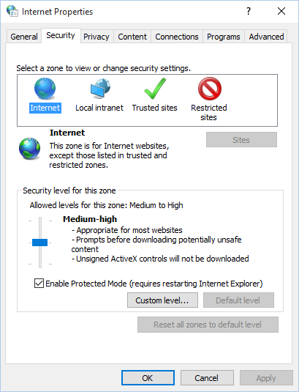
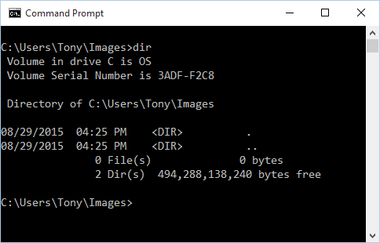
1.5 Graphical User Interface
User interfaces allow users to interact with the computer. Categories are:
Command line interface (aka console interface)
Graphical user interface (GUI)- now the most commonly used

Slide 19
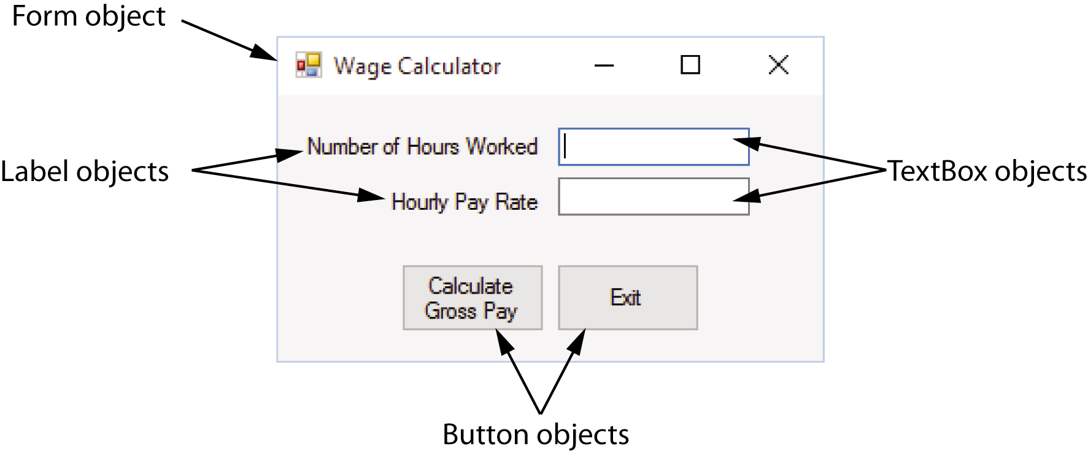
1.6 Objects
Most programming languages use object-oriented programming in which a program component is called an “object”
Program objects have properties (or fields) and methods
Properties – data stored in an object
Methods – the operations an object can perform

Slide 20
Controls
Objects that are visible in a program GUI are known as controls
Commonly used controls are Labels, Buttons, and TextBoxes
They enhance the functionality of your programs
There are invisible objects in a GUI such as Timers, and OpenFileDialog

Slide 21
The .NET Framework
The .NET Framework is a collection of classes and other codes that can be used to create programs for Windows operating system
C# is a language supported by the .NET Framework
Controls are defined by specialized classes provided by the .NET Framework
You can also write your own class to perform a special task

Slide 22
1.7 The Program Development Process
The process of creating a program is known as the programming development cycle
It has six phases:
Understand the program’s purpose
Design the GUI
Design the program’s logic
Write the code
Correct syntax errors
Test the program and correct logic errors

Slide 23
Algorithm, Pseudocode, Flowchart
An algorithm is a set of well-defined, logical steps that must be taken to perform a task
An algorithm that is written out in plain English is called pseudocode
A flowchart is a diagram that graphically depicts the steps of an algorithm

Slide 24
1.8 Getting Started with the Visual Studio Environment
Visual Studio 2015 is a professional integrated development environment (IDE)
You may install Visual Studio 2015 Community Edition (free programming environment available from download from Microsoft)
The Visual Studio Environment includes:
Designer Window
Solution Explorer Window
Properties Window

Slide 25
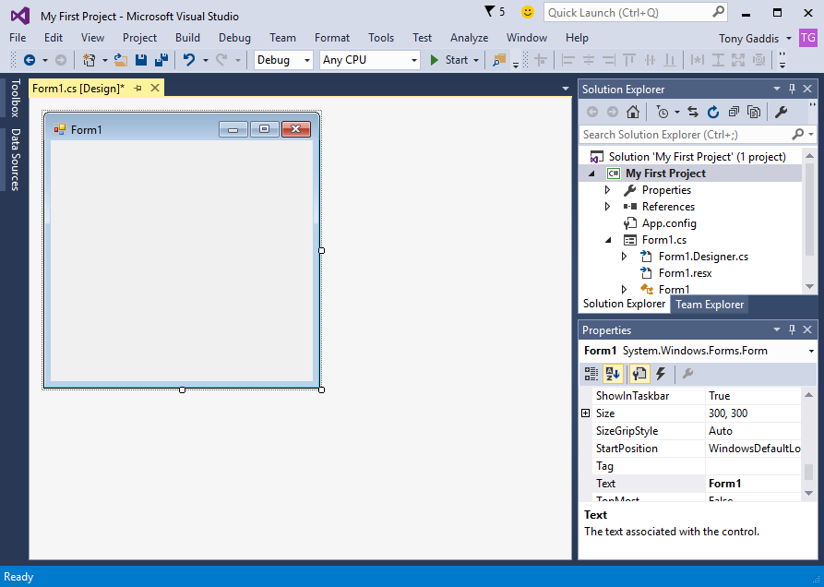
1.8 Getting Started with the Visual Studio Environment
The Designer

Slide 26
1.8 Getting Started with the Visual Studio Environment
Solution Explorer

Slide 27
1.8 Getting Started with the Visual Studio Environment
Properties Window

Slide 28
1.8 Getting Started with the Visual Studio Environment
Auto Hide allows a window to display only as a tab of the edges
Pushpin icon means it supports Auto Hide

Slide 29
Menu Bar and Standard Toolbar
Menu bar provides menus such as File, Edit, View, Project, etc.
Standard toolbar contains buttons that execute frequently used commands

Slide 30
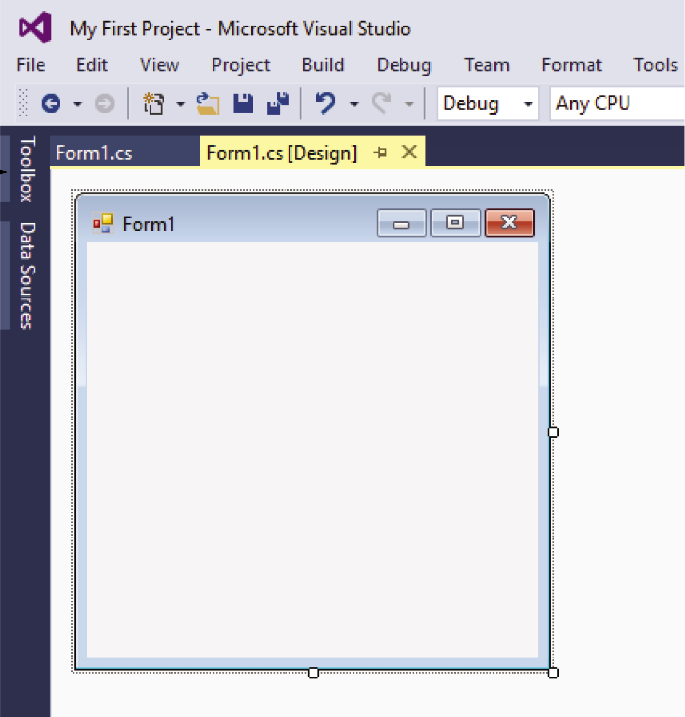
The Toolbox
Toolbox is a window for selecting controls to use in an application
Typically appears on the left side of Visual Studio environment
Usually in Auto Hide mode
Toolbox tab

Slide 31
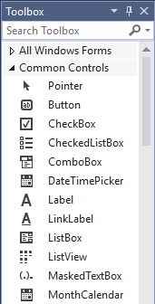
The Toolbox
Toolbox is a window for selecting controls to use in an application
Divided into sections such as “All Windows Forms” and “Common Controls”

Slide 32
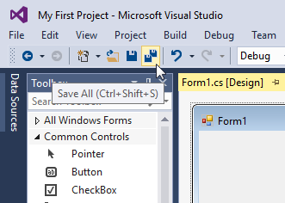
Tooltips
A Tooltip is a small box that pops up when you hover the mouse pointer over an item on the toolbar or toolbox.
Tooltip

Slide 33
Docked and Floating Windows
When a window such as Solution Explorer is docked, it is attached to one of the edges of the Visual Studio environment
When a window is floating, you can click and drag it around the screen
A window cannot float if it is in Auto Hide mode
Right click a window’s title bar and select Float or Dock to change between them

Slide 34
Projects and Solutions
Each Visual Studio application (including Visual C#) you will create is a project
A project contains several files.
Typically they are Form1.cs, Program.cs, etc.
A solution is a container that can hold one or more Visual Studio (including Visual C#) projects
Each project, however, is saved in its own solution
Solution
Project
Files belonging to the project

Slide 35
Specifying the Project Name
You can specify the project name the first time you save the project.

Slide 36
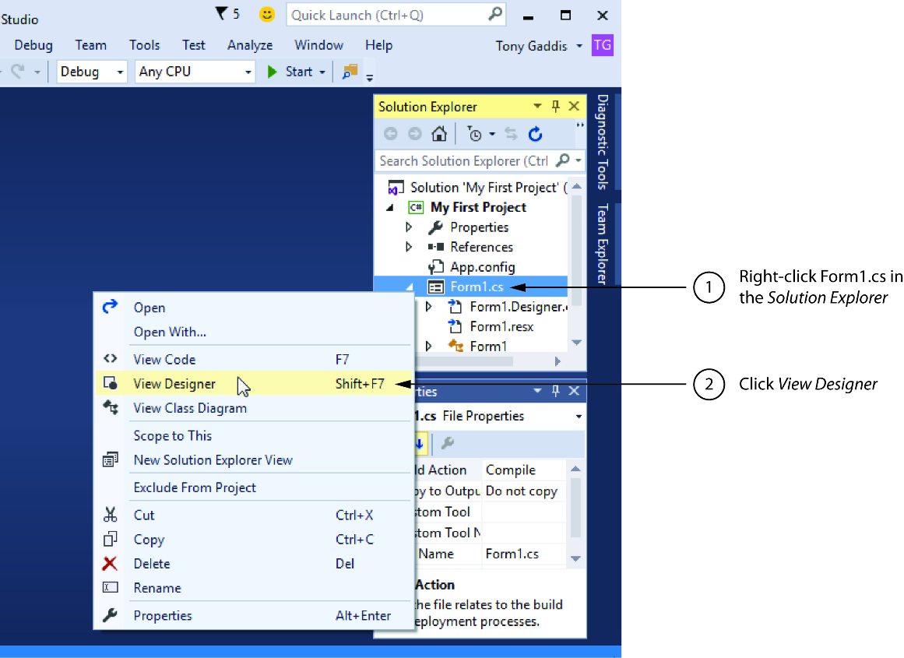
Displaying the Designer
Sometimes when you open an existing project, the project’s form will not be automatically displayed in the Designer
You should:
Right click Form1.cs in the Solution Explorer
Click View Designer in the pop-up menu

